Slide 1

Multi-Use
Trails
Logan Martin & Emma Heisig
Mr. Matthew Miller
DE Capstone Engineering
14 May 2024
Notes:
*Emma

Slide 2
What’s the Problem?
Why Do We Care?
Lack of, or outdated, data on how Multi-Use Trails, specifically Triangle Trails, impact the CHS community.
We are members of the CHS community!
We’ve seen how transportation issues can affect students
When we understand the needs of our community, we can improve our community.

Slide 3
Solutions and Goals
Collect data on people’s opinions and usage of Triangle Trails
Spark meaningful change around transportation at Charlottesville High School
Be able to provide the City of Charlottesville, as well as Charlottesville City Schools, with this data
Notes:
*Emma.*
*All-the-while having meetings with our customers to discuss progress and direction.*
As we research more ways to gather data, we will split work accordingly. If a team member runs into a roadblock, we might need to revisit how/what data we are collecting. If a team member is absent, that person should do their best to get back the time they missed during BKT or afterschool. If that fails, the data collection method the absent team member is working on will need to be revisited or cut.

Slide 4
People Involved
UVA Link Lab:
Carreen de Cardenas
Avi Hoen
City of Charlottesville:
Ben Chambers; Transportation Manager
Tommy Safranek; Bike & Ped. Coordinator

Slide 5
Essential Requirements - From Proposal
1
2
3
4
Collect data on when people use the trails
Design and build sensors in-lab, keeping privacy in mind
Find out use patterns of the trails
Analyze collected data to propose how trails could be improved
Notes:
*Emma

Slide 6
Non-Essential Requirements - From Proposal
1
2
3
4
Take community survey
Find out demographics of people who use the trails
Add physical change to Triangle Trails
Observe patterns immediately surrounding the trails
Notes:
*Emma

Slide 7
Weeks 1-3
Research how to collect data, order parts
Weeks 17-22
Draw larger conclusions with guidance from experts
Weeks 4-7
Build and test data collection system
Weeks 23-24
Prepare for final presentation
Weeks 8-16
Collect, organize, and interpret data
Timeline from Proposal
Notes:
*Emma.*
*All-the-while having meetings with our customers to discuss progress and direction.*
As we research more ways to gather data, we will split work accordingly. If a team member runs into a roadblock, we might need to revisit how/what data we are collecting. If a team member is absent, that person should do their best to get back the time they missed during BKT or afterschool. If that fails, the data collection method the absent team member is working on will need to be revisited or cut.

Slide 8
Essential Reqs.
Collect data on when people use the trails
Design and build sensors in-lab, keeping privacy in mind
Find out use patterns of the trails
Analyze collected data to propose how trails could be improved
Non-Essential Reqs.
Take community survey
Find out demographics of people who use the trails
Add physical change to Triangle Trails
Observe patterns immediately surrounding the trails
✔
✔
✔
✔
✔
✔

Slide 9
The Data We Collected - Part 1 of 3: Walking Need
Sanitized Walking Survey Responses
Q: Do you walk to school? Q: Would CHS benefit from a route map?
Total Respondents - 136 Total Respondents: 52
“No, and I don’t want to.” - 84 (62%) “No” - 21 (40%)
“No, but I want to.” - 13 (10%) “Maybe” - 3 (6%)
“Yes.” - 39 (27%) “Yes” - 28 (54%)
What Stops People: Distance, Time, Infrastructure

Slide 10
The Data We Collected - Part 2 of 3: Biking Need
Sanitized Biking Survey Responses
Q: Would you like to bike to school? Q: Would CHS benefit from more
Total Respondents - 147 bike racks?
“I would not” - 95 (65%) “No” - 39 (27%)
“Yes, but I can’t” - 32 (22%) “Yes” - 108 (73%)
“I already do.” - 20 (13%)
What Stops People: Distance, Time, Infrastructure

Slide 11
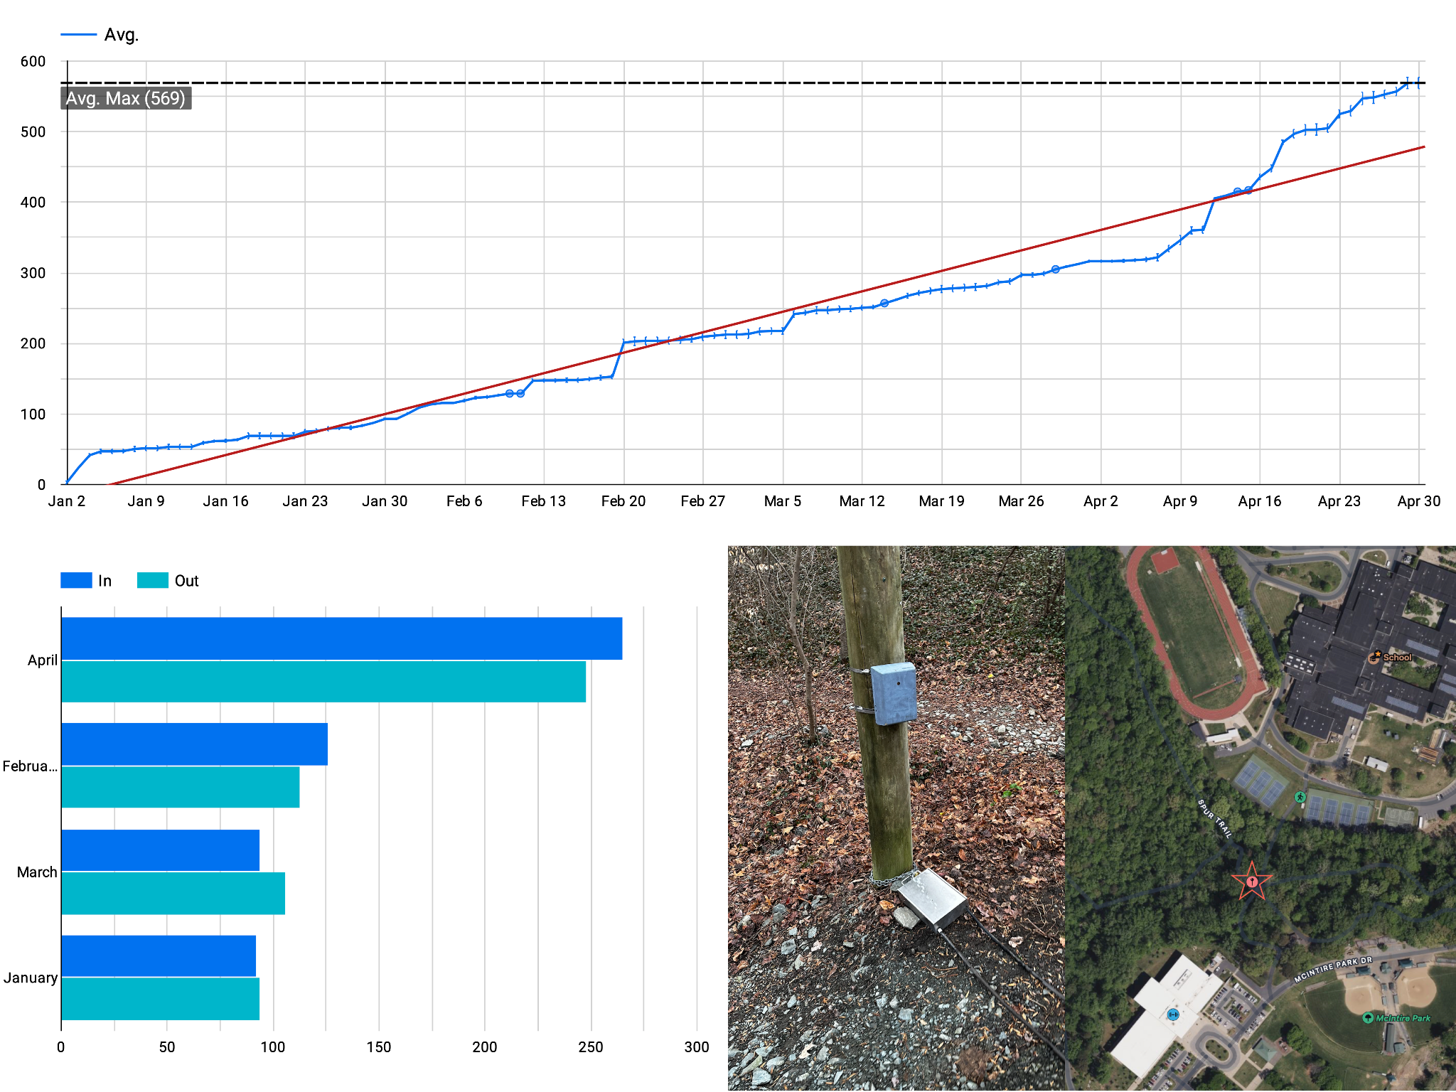
The Data We Collected - Part 3 of 3: Triangle Trail

Slide 12
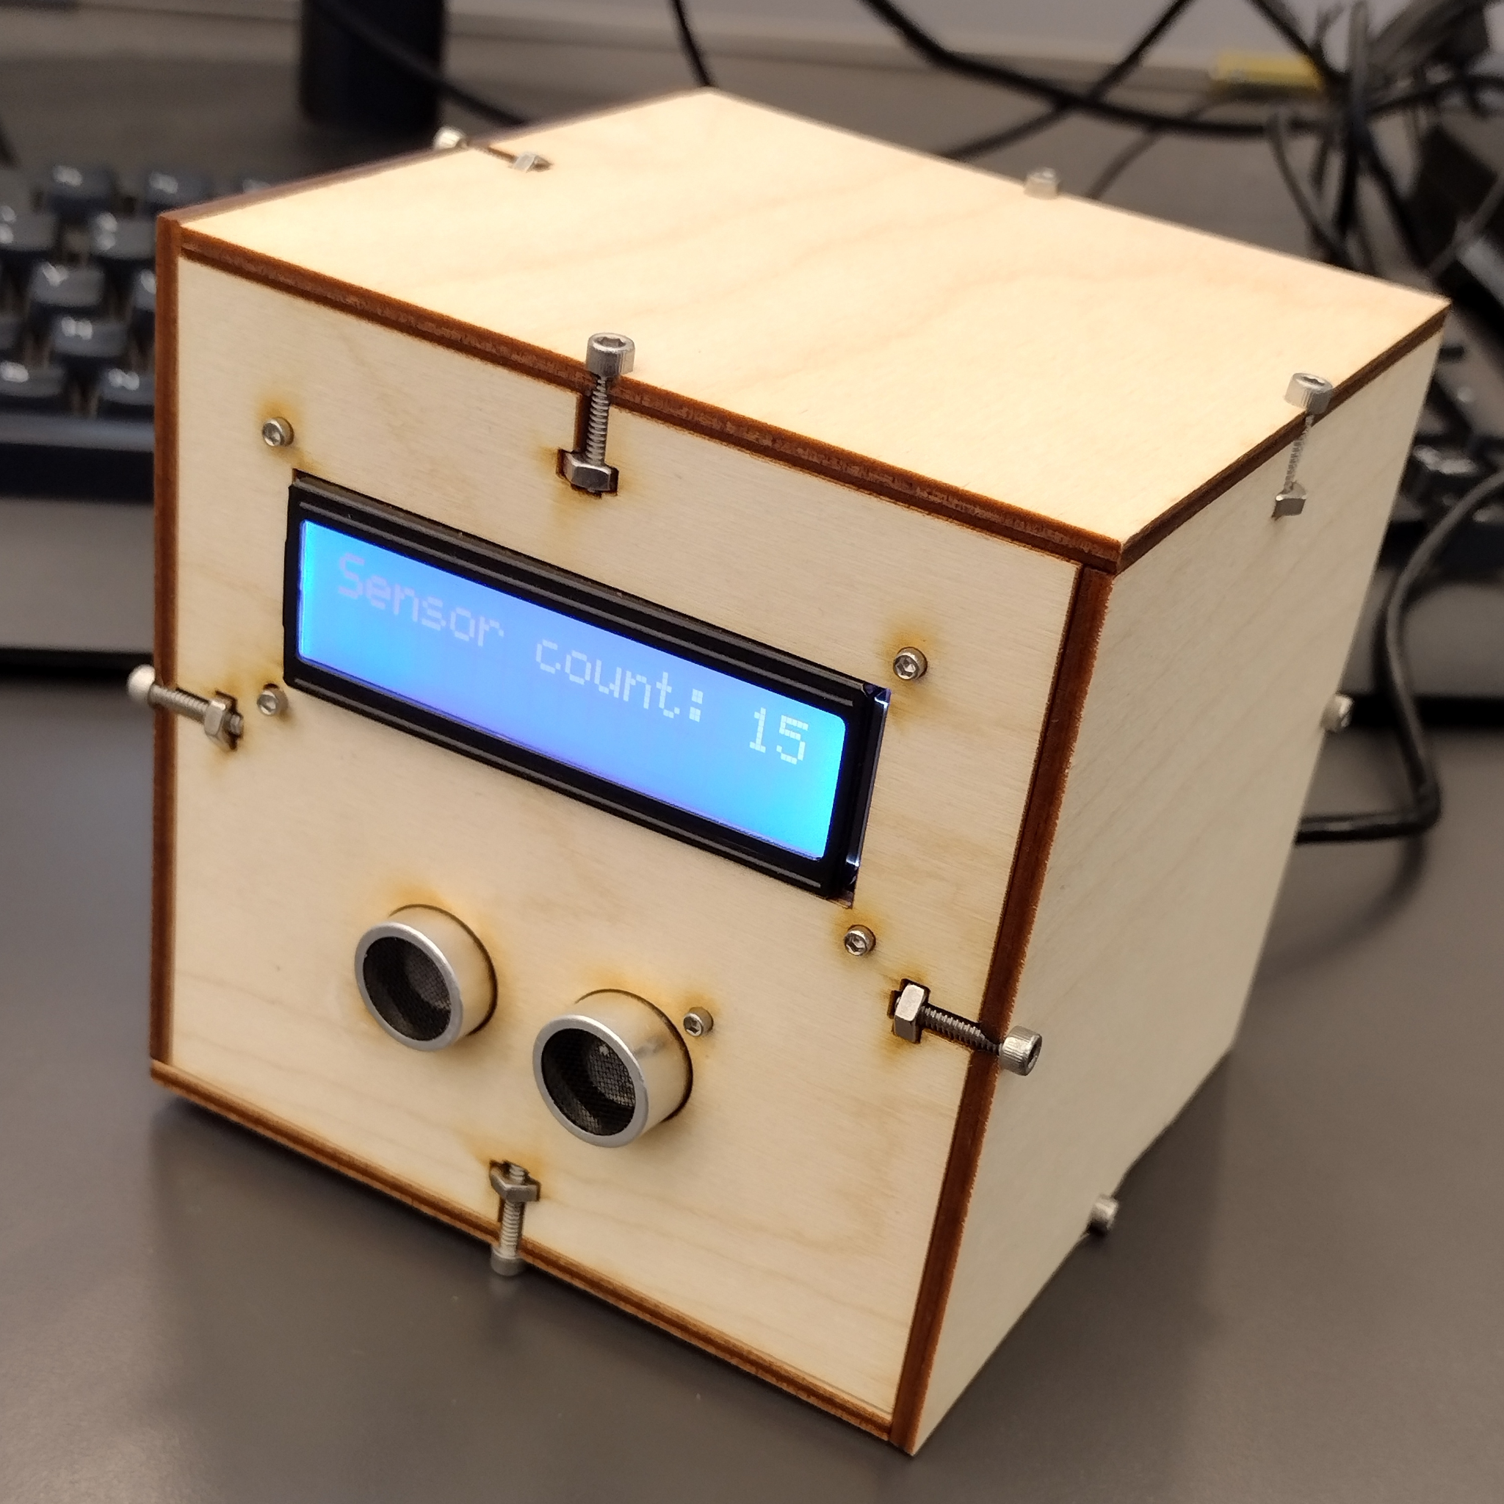
The Physical Counter: Intro - Part 1 of 2
Why we made this:
To better understand the design of a data collection counter.
What makes a "Good" counter?
Having a long-range sensor, high battery power, reliable data collection and storage, and a way to reset the data on the counter.

Slide 13
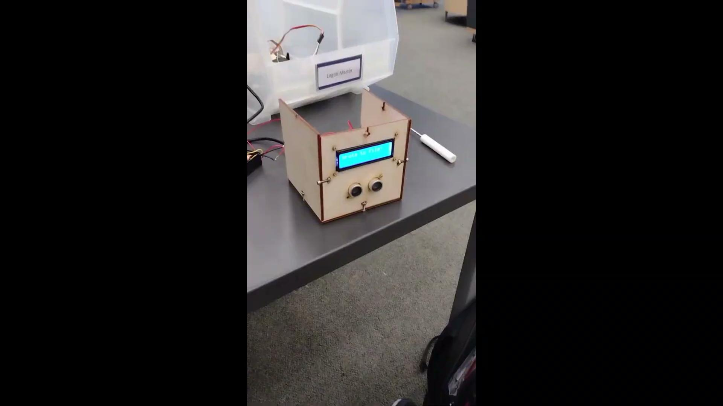
The Physical Counter: Redesign - Part 2 of 2
Downsides:
No Battery
Needs to be plugged into computer to work.
No Storage of data
Short-range sensor
Annoyances w/ Physical Assembly
What we set out to Fix:
Adding an external battery & save data

Slide 14
Conclusion, Q&A
Big thanks to our mentors, Mr. Safranek, Mr. Miller, and others who helped with this project!

